Slide 1
CSCI 1130 Tutorial One

Slide 2
Using Java SE (JDK) with NetBeans 8.2
CSCI 1130
Tutorial one

Slide 3
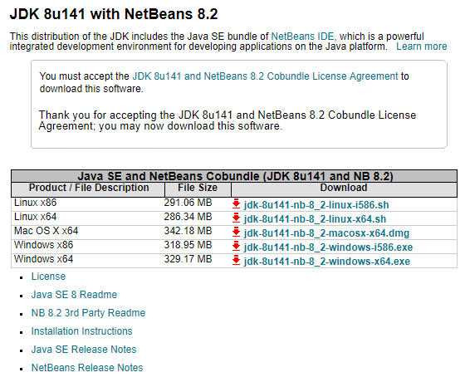
JDK 8.x + NetBeans IDE 8.2.x (BUNDLED download and install)
http://www.oracle.com/technetwork/java/javase/downloads/jdk-netbeans-jsp-142931.html
Download it according to your OS!

Slide 4
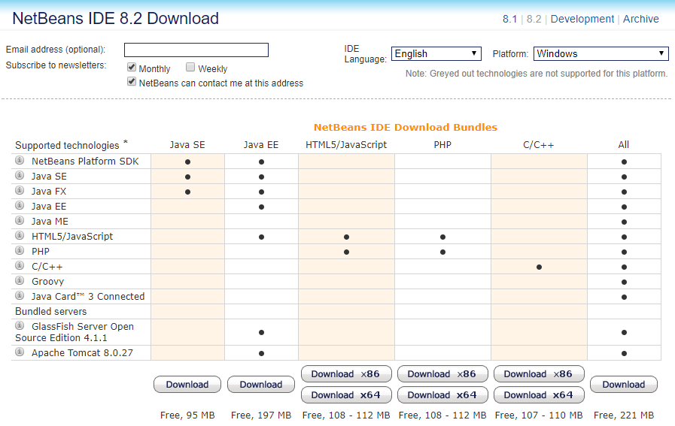
Download NetBeans IDE 8.2 SEPARATELY
https://netbeans.org/downloads/

Slide 5
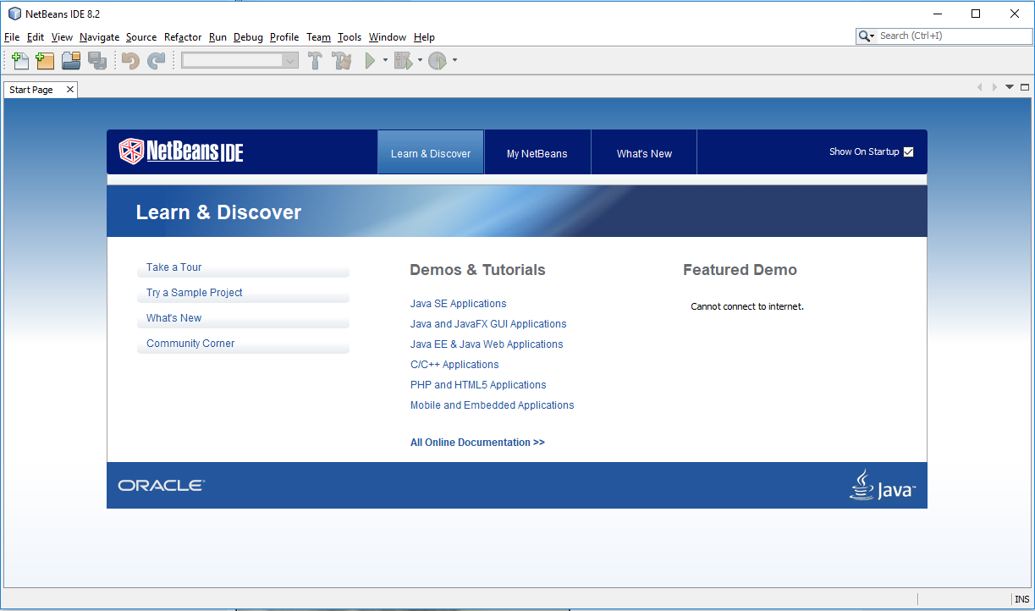
Create a New Project
Click “New Project…”

Slide 6
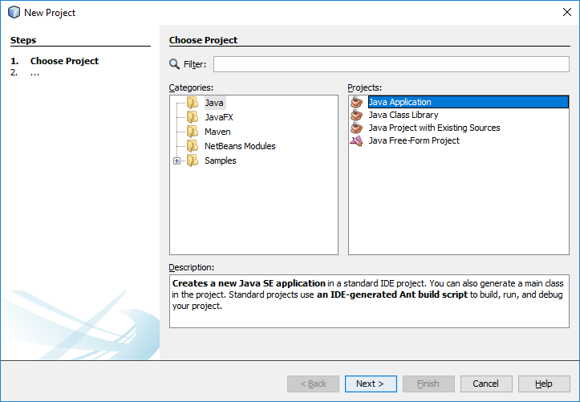
Java → Java Application

Slide 7
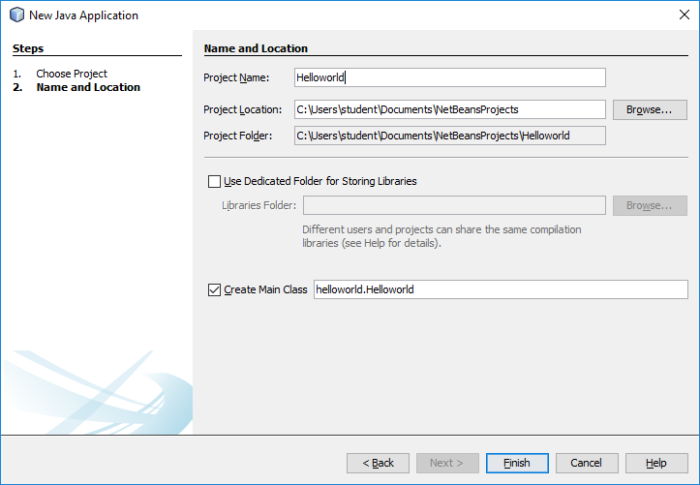
Give Project Name and Location
Store the project anywhere you like but please remember the location!
The default is recommended!
Click “Finish”

Slide 8
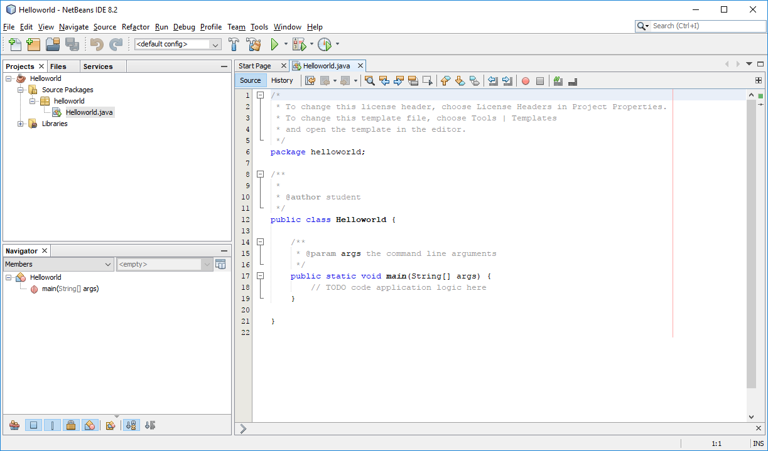
Initial Java Project
A new initial Java source file is created automatically!

Slide 9
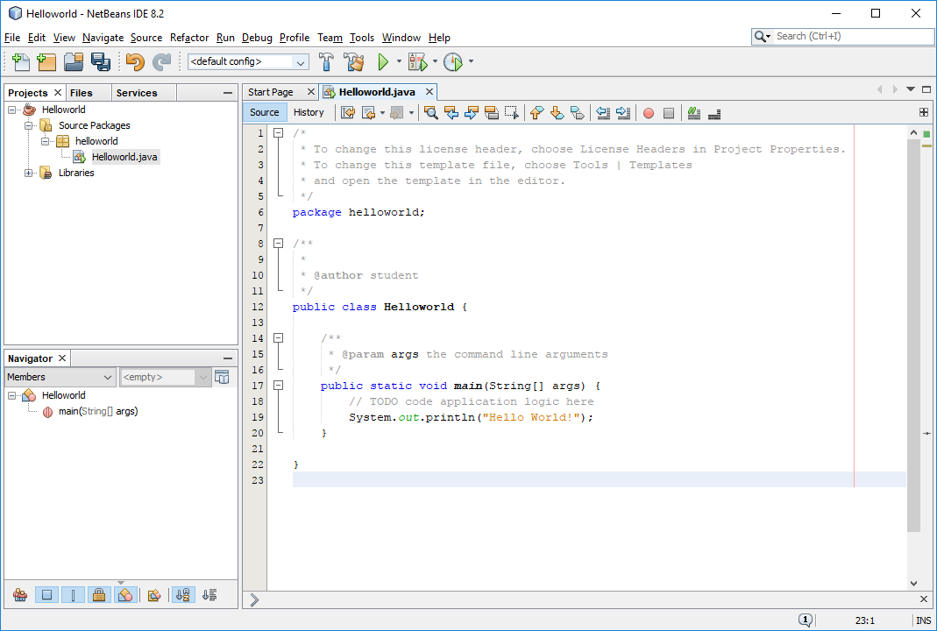
Exercise1: Hello World!

Slide 10
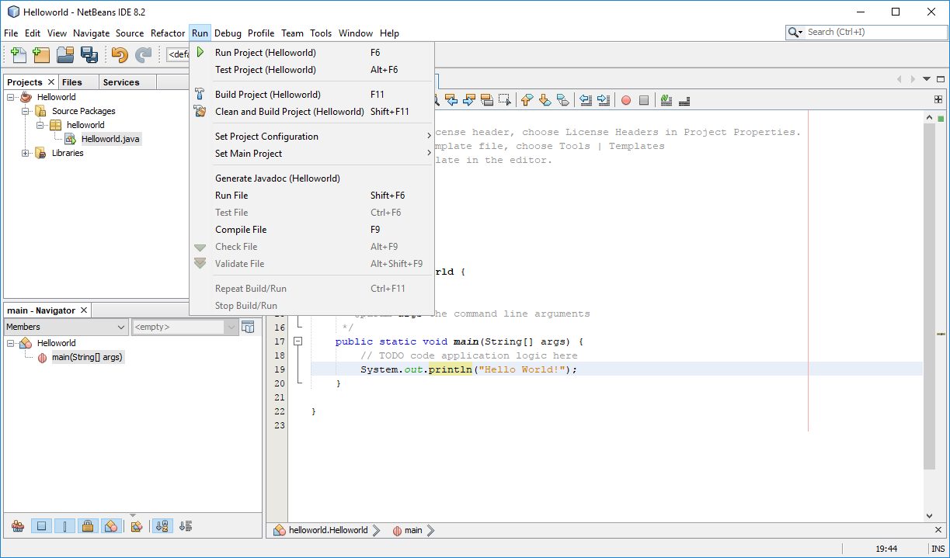
Build your Project
“Run Project (F6)” will perform “Build Project” and RUN the program.
“Build Project (F11)” will check your source code and compile your program.
Click “Clean and Build Project” if you encounter any mysterious problem…

Slide 11
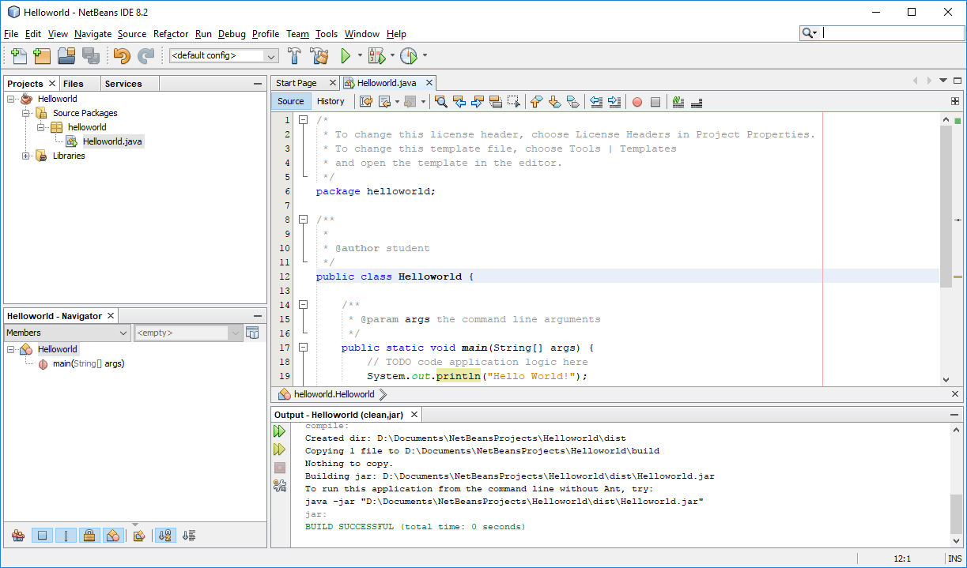
How to Build a Project

Slide 12
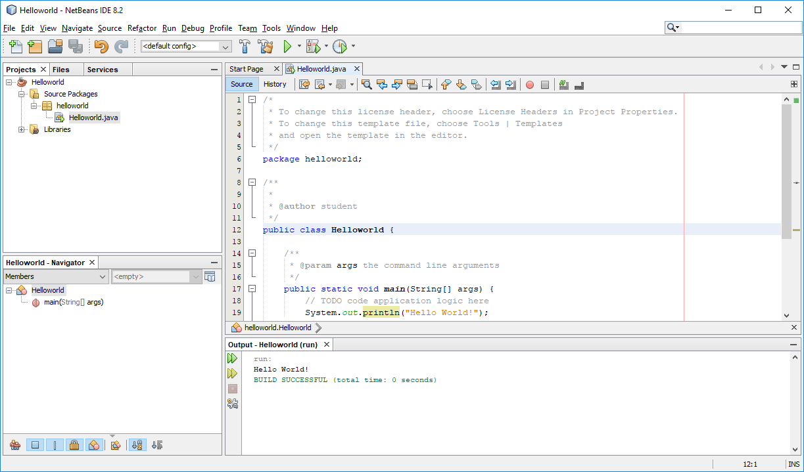
How to Run

Slide 13
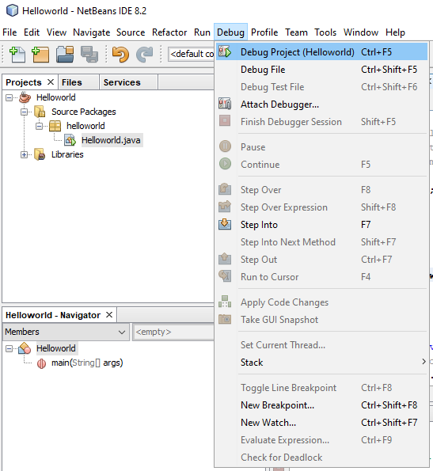
How to Debug
“Debug Project” is another way to Run your Project, it will also perform “Build Project” and RUN the program with debugger support.

Slide 14
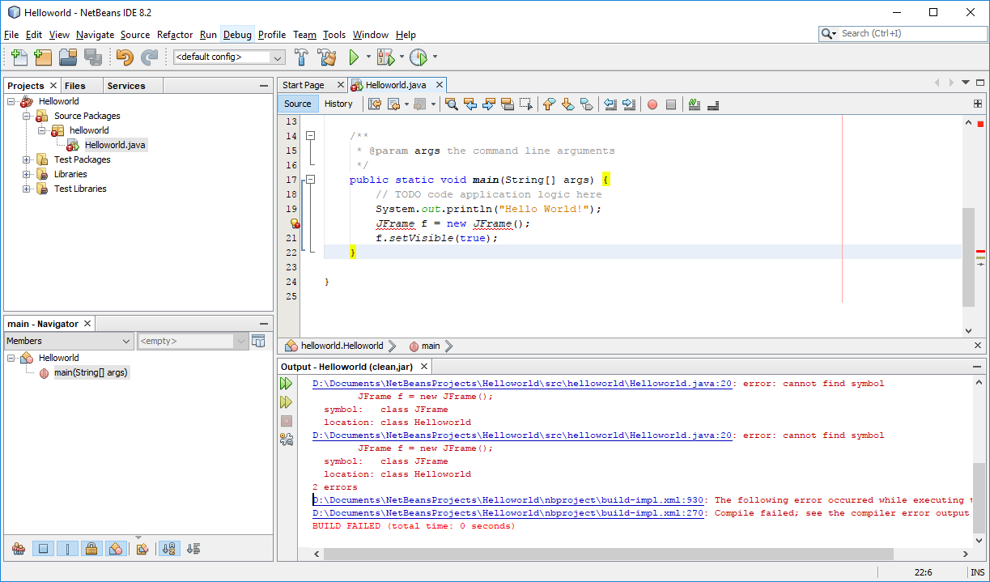

Exercise2: Create a JFrame

Slide 15
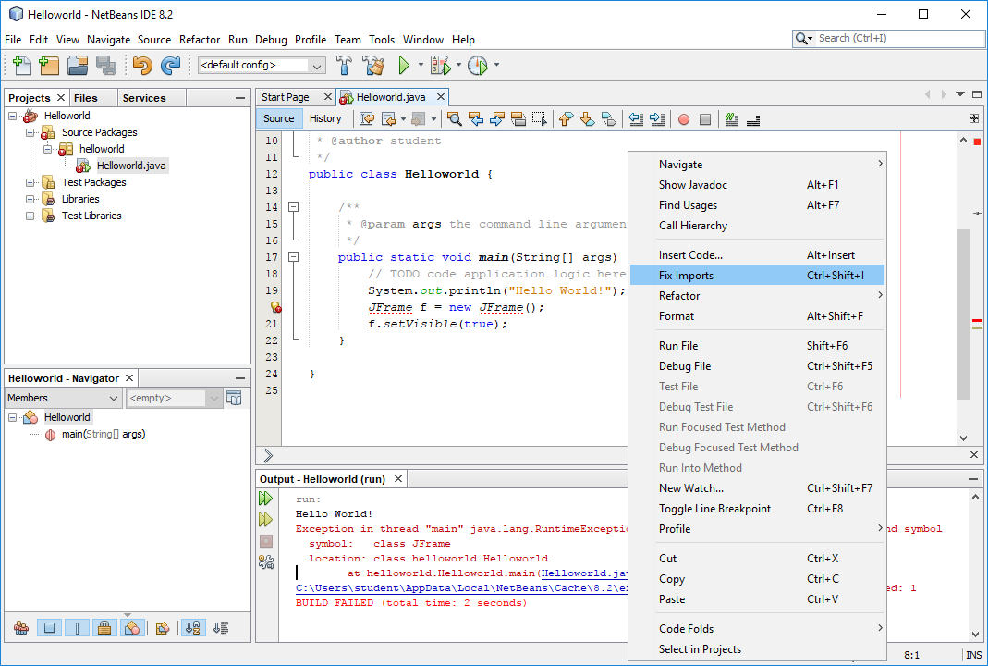
Right-click → Fix Imports

Slide 16
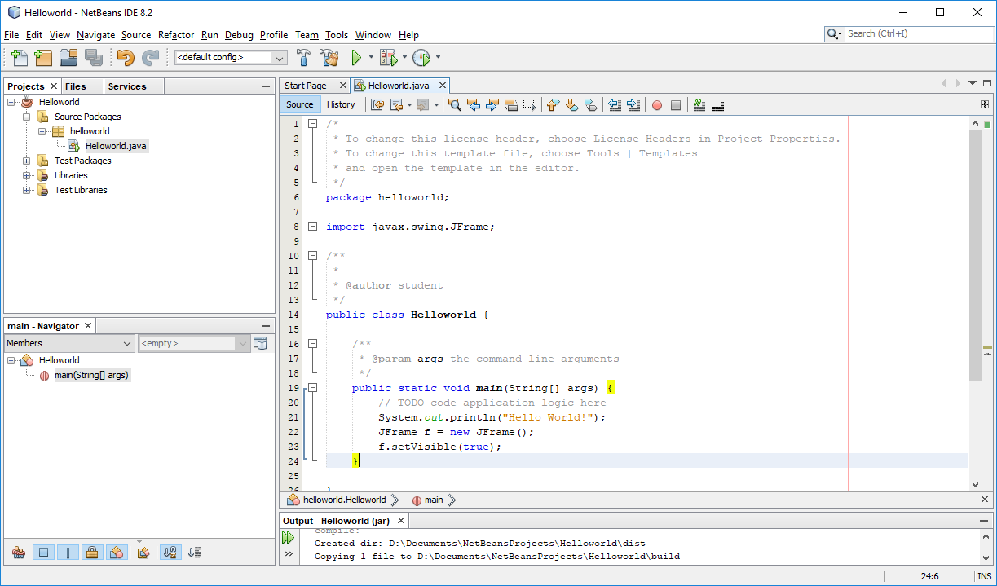
Build Again

Slide 17
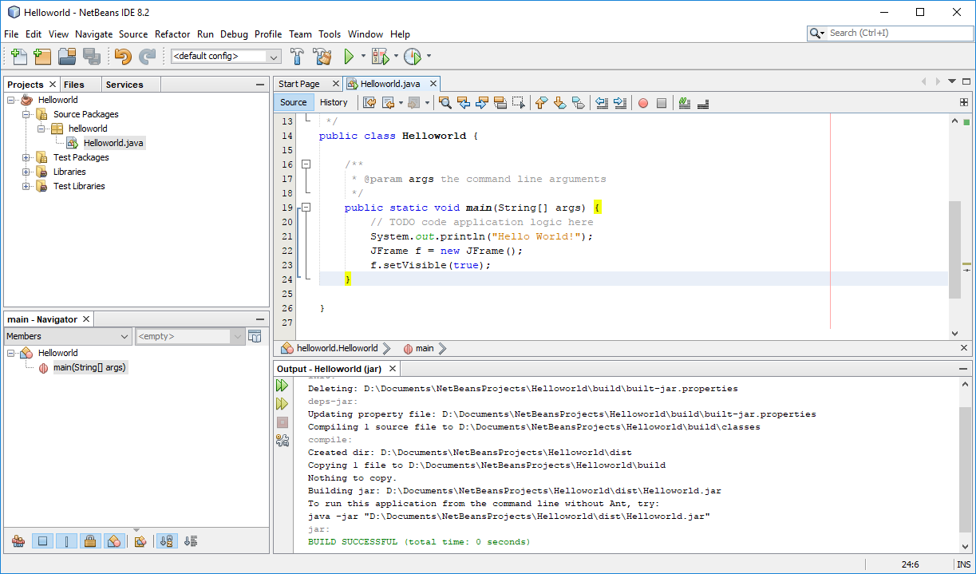
Build Successful
Click “Clean and Build”

Slide 18
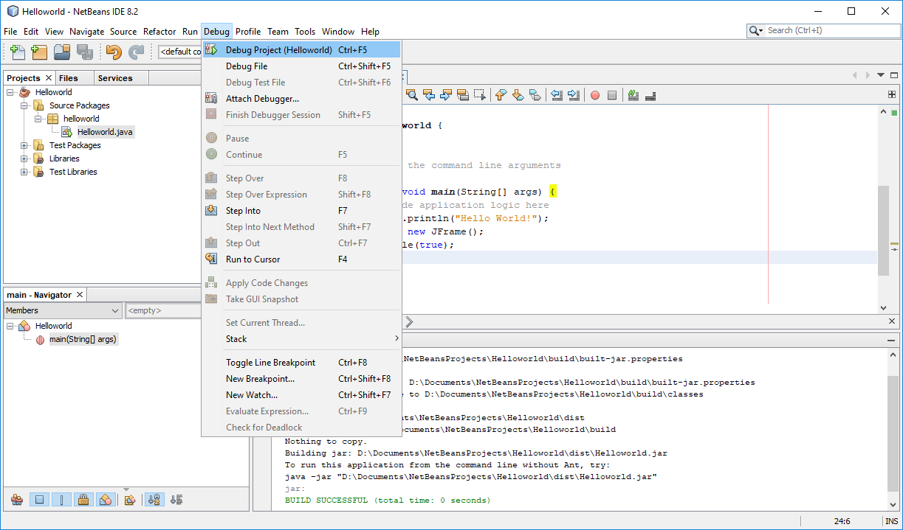
Debug Main Project

Slide 19
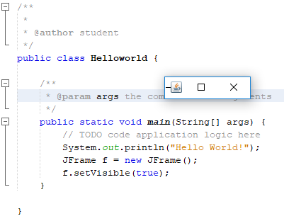
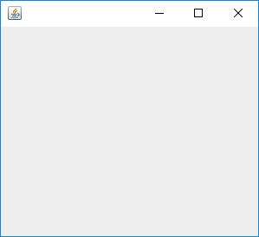
A JFrame Window is Shown! Let’s Resize it…
Clicking this little cross ONLY dismisses the JFrame window,
BUT the program will still be running in the background…

Slide 20
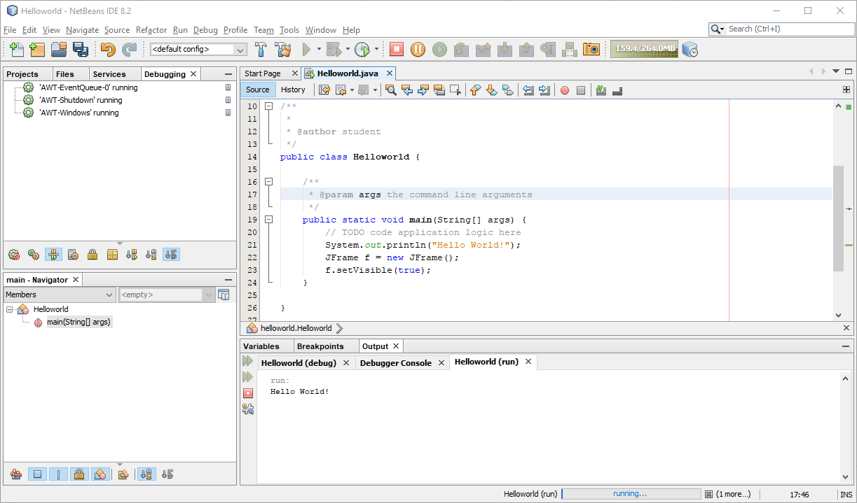
Finish Debugger Session
To stop this simple program,
we have to finish the Debugger Session.

Slide 21
Summary
You have learnt…
Download and Install JDK as well as NetBeans
Launch NetBeans
Create a New Java Application Project
Edit a simple “Hello World” program
Build/ Run/ Debug a project
Create a simple JFrame window
Fix a simple kind of error by clicking [Fix Imports]
Finish a Debugger Session

Slide 22
Assignment 1
1. Get acquaint with the NetBeans Java programming environment.
2. Learn the structure and format of a Java program by example.

Slide 23
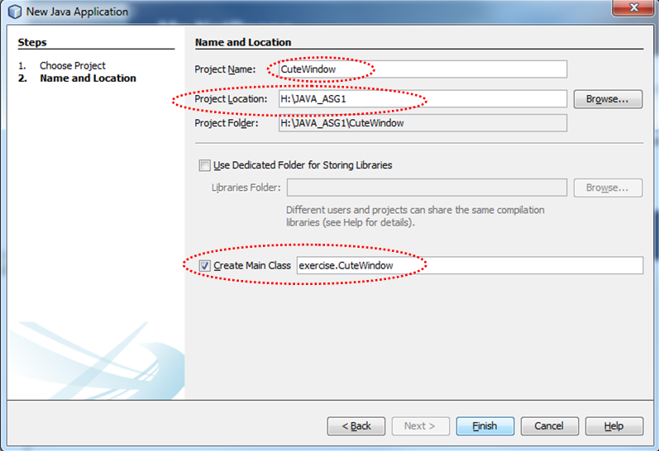
Procedure

Slide 24
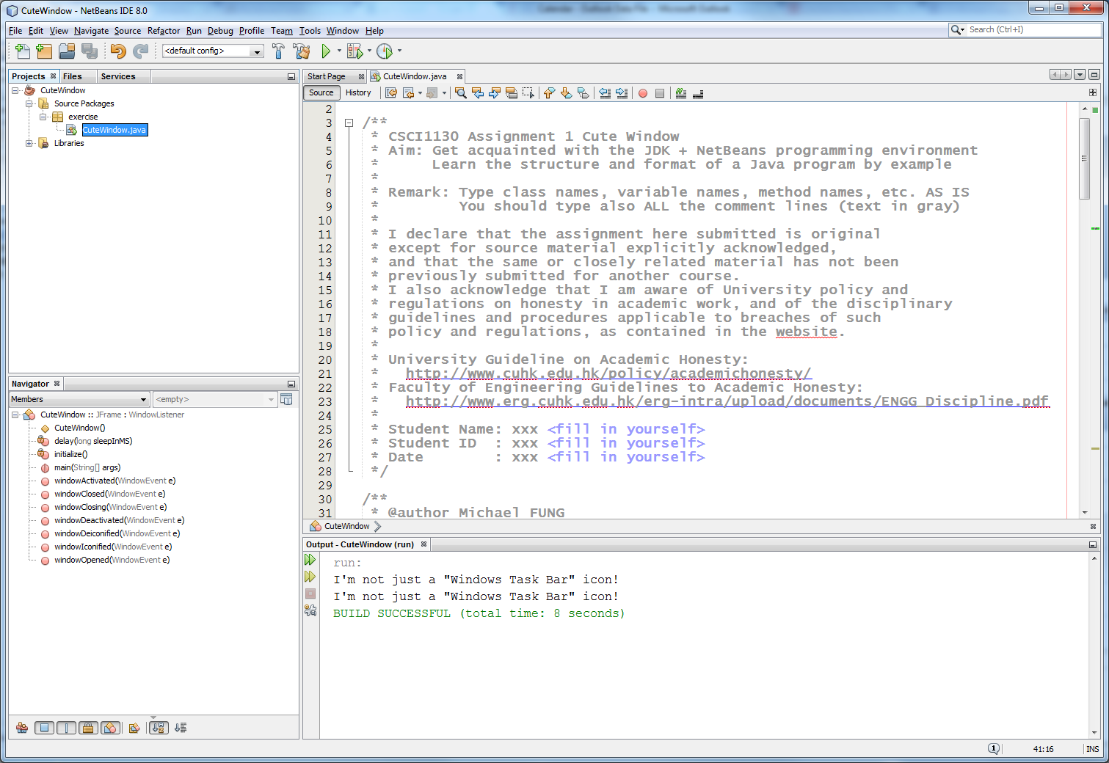
Procedure
Project window shows the CuteWindow project organization tree structure.
As you type the program in the Editor window, this Navigator window will grow and change!
Editor window. Colour highlighting shows syntax of the code.
Press key <F6> to Run (Build/Compile and Run in one shot)
Output window shows you error and warning messages.
Some of them are clickable!

Slide 25
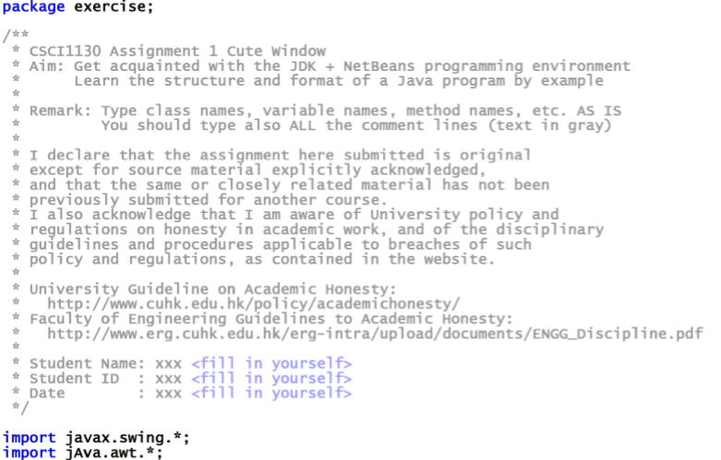
Procedure
Please fill in your own student ID, name and date here!

Slide 26
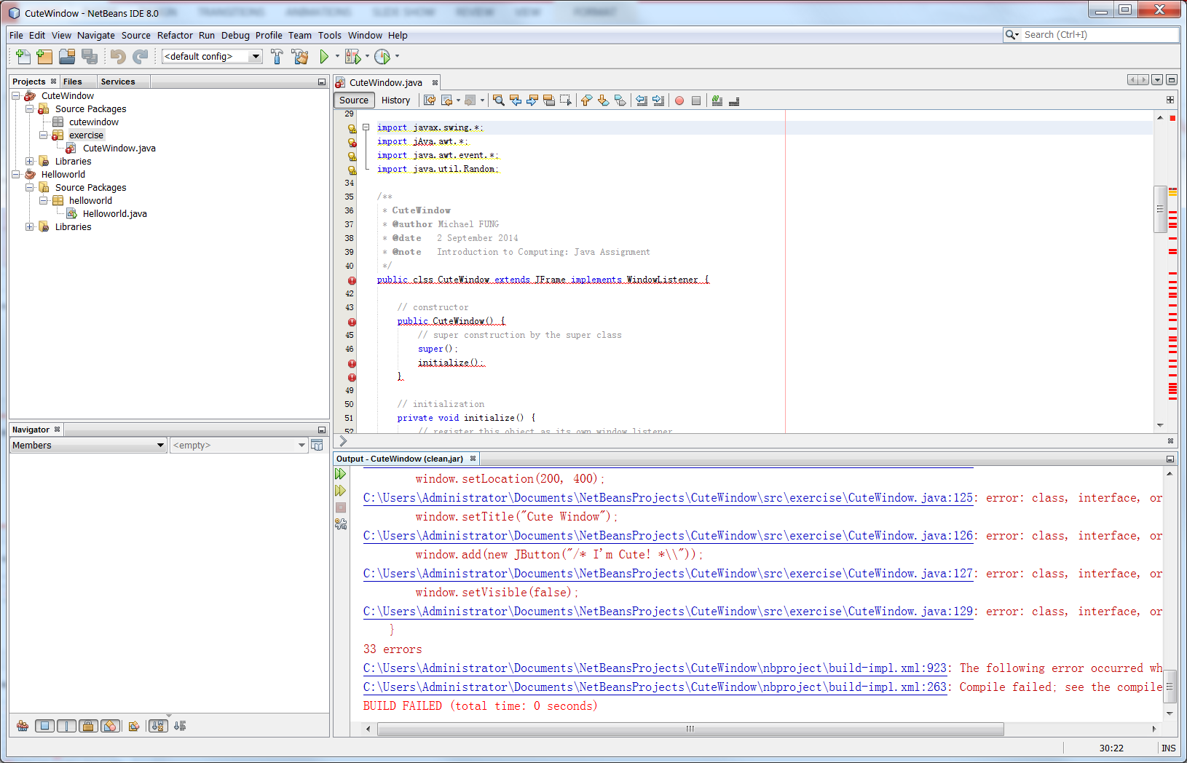
Fix BUGS

Slide 27



Fix Simple Bugs
Case sensitive: wrong letter case/ spelling mistake
Missing semicolon
wrong case/ spelling
right
wrong
right

Slide 28



Fix Simple Bugs
Method parentheses mismatch
Incorrect argument syntax
wrong
right
wrong
right

Slide 29
Submit Your Assignment
1. Locate your NetBeans project folder, e.g. H:\JAVA_ASG1
2. ZIP the project folder CuteWindow and Submit the file CuteWindow.zip via our Online Assignment Collection Box on Blackboard <https://blackboard.cuhk.edu.hk>

Slide 30
Marking Scheme and Notes
1. The submitted program should be free of any typing mistakes, compilation errors and warnings.
2. Comment/remark, indentation, style are under assessment in every programming assignments unless specified otherwise. This program gives you an example of a well-formatted source file. Variable naming, proper indentation for code blocks and adequate comments are important.
3. Remember to do your submission before 6:00 p.m. of the due date. No late submission would be accepted.
4. If you submit multiple times, ONLY the content and time-stamp of the latest one would be counted. You may delete (i.e. take back) your attached file and re-submit. We ONLY take into account the last submission.

Slide 31
Things to TRY
1. Locate your NetBeans project folder and find a file CuteWindow.jar. Double click it!
2. Change the spiral speed and/or range.
3. Add your own cute behaviors.

Slide 32
The End

